Slide 1
History of Games <3
By Daniel Möller [PRESS START]

Slide 2


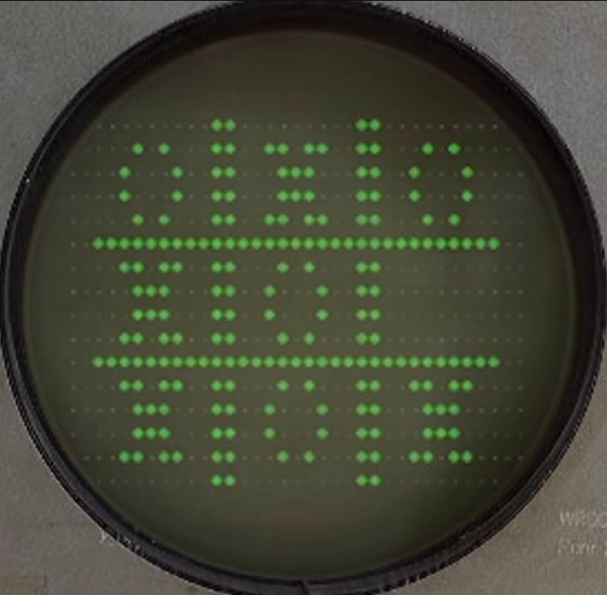


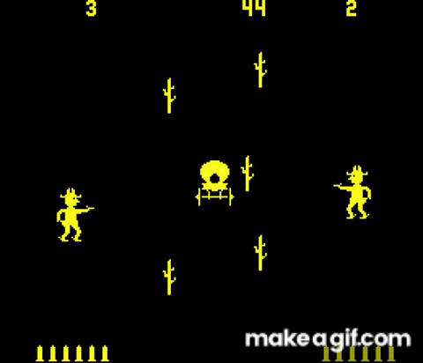
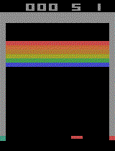
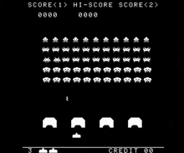
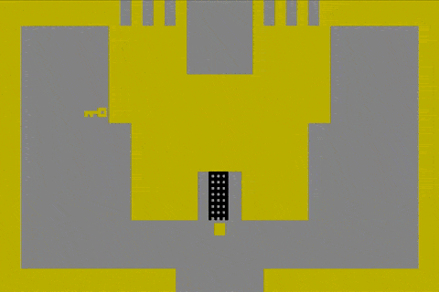





Early Game
Computer Space (1971, Atari)
OXO (1952)
Tennis 4 2(1958)
Space War! (1962)
Pong (1972, Atari)
Gunfight (1975, Midway)
Breakout (1976, Atari)
Space Invaders (1978, Atari)
Adventure (1979, Atari)

Slide 3
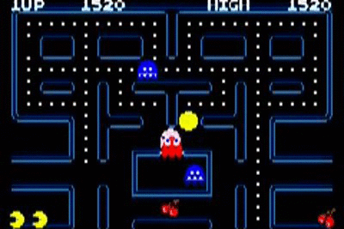
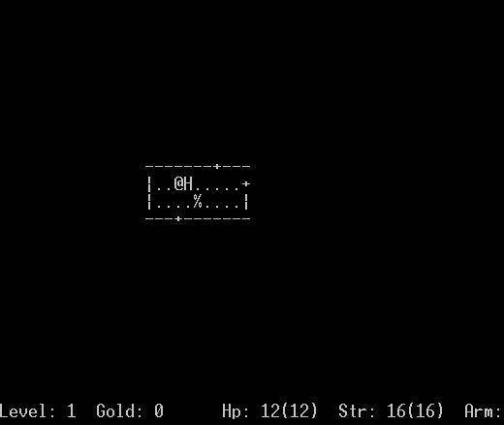
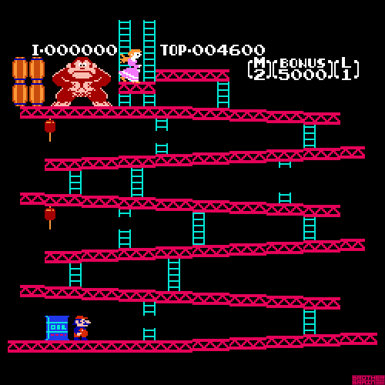

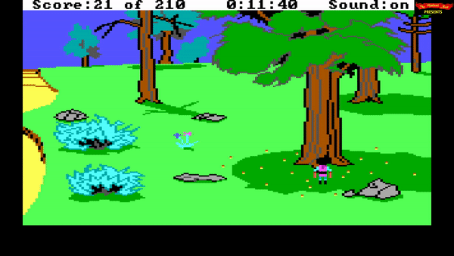
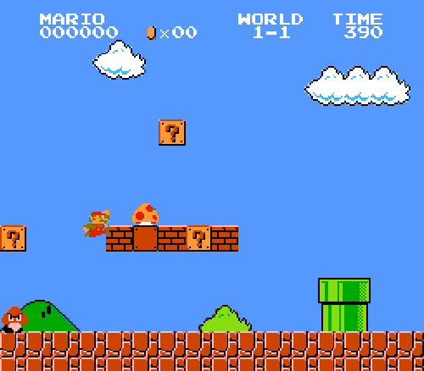
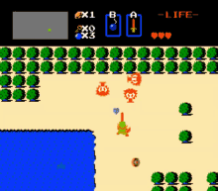
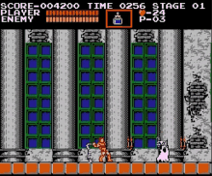
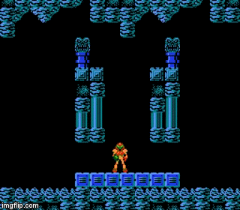
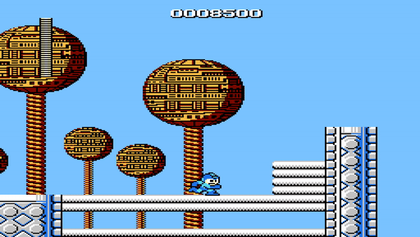
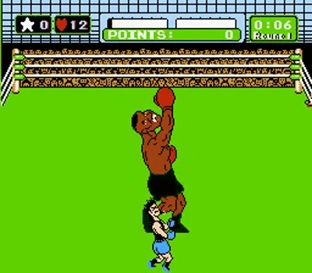
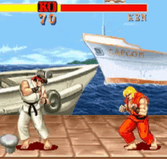
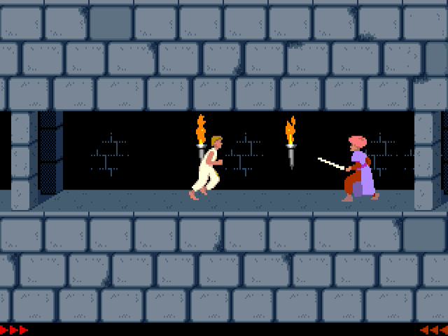




Midgame
The 80s were a turbulent time for video games. Poorly made games like the infamous ET game caused the market to crash. But where giants fall, other came to pick up the pieces. Tokyo became a mecca for clinging coins. Konami, Nintendo, Namco were all founded in Japan, with SEGA transitioning from Hawaii to Tokyo aswell.
Pac Man (1980, Namco)
Rogue (1980, Epyx)
Donkey Kong (1981, Nintendo)
Tetris (1981, Nintendo)
Kings Quest (1984, Sierra Online)
Super Mario Bros. (1985, Nintendo)
Legend of Zelda (1986, Nintendo)
Castlevania (1986, Konami)
Metroid (1986, Nintendo)
Mega Man (1987, Nintendo)
Punch-Out! (1987 Nintendo)
Street Fighter 1
(1987, Capcom )
Prince of Persia (1989, Broderbund)

Slide 4
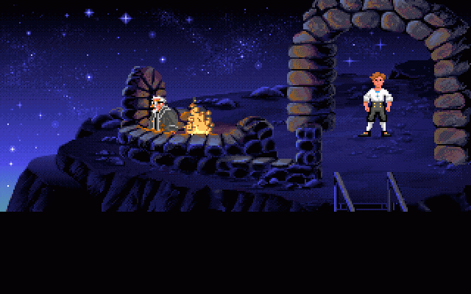
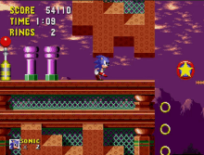
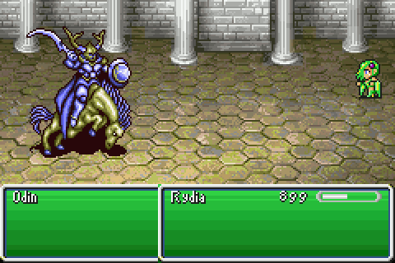
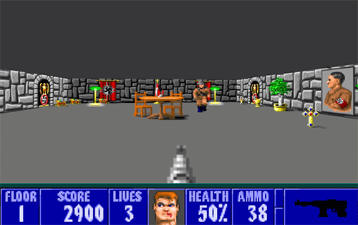

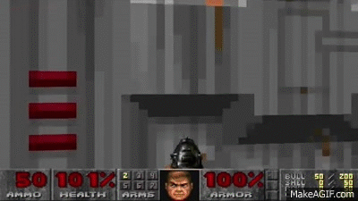
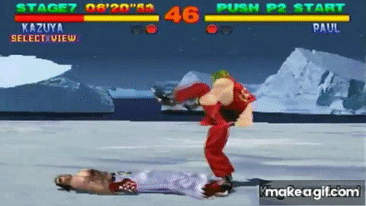

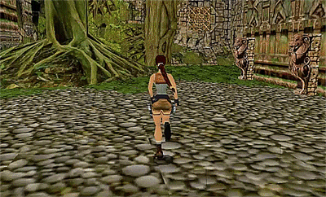

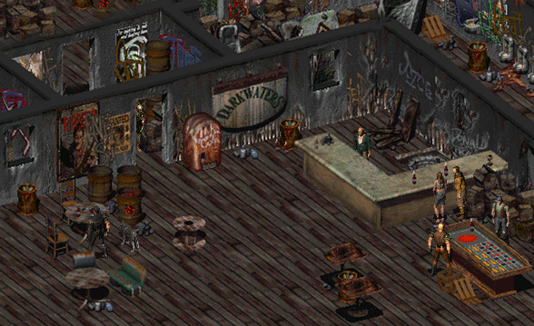
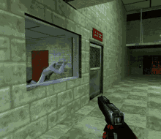
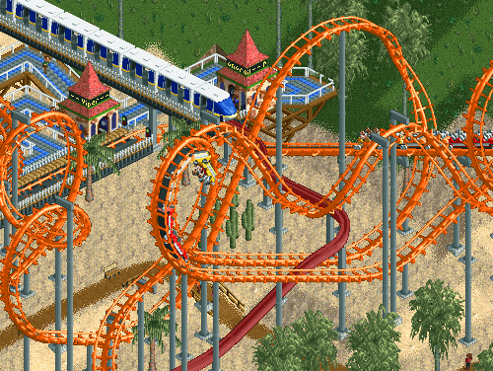
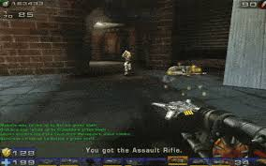
late game
Final Fantasy 4 (1991, Square Enix)
Wolfenstein 3d (1992, id Software)
Kirbys Dreamland (1992, HAL )
Doom (1994, id Software)
Tekken (1994 Namco)
Monkey Island 1 (1990, LucasArts)
Sonic 1 (1991, SEGA)
Tomb Raider (1996, Core Design)
Pokemon (1996, Game Freak)
Fallout1 (1997, Interplay & Black Isle Studio)
Half Life 1 (Valve, 1999)
Roler Coaster Tycoon (1999, Hasbro)
Unreal Tournament (1999, Epic games)
Rayman (1995, Ubi Soft)

Slide 5

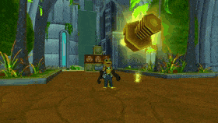
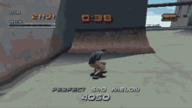
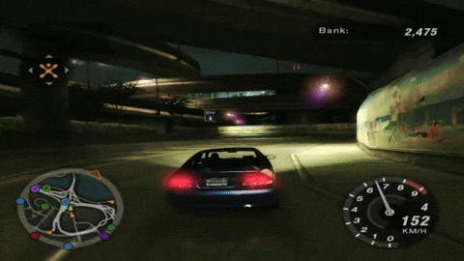
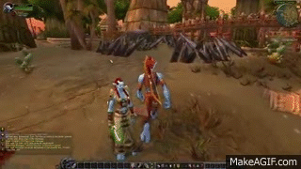



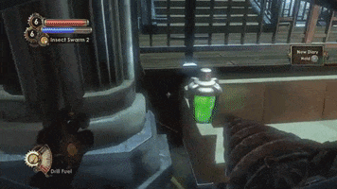


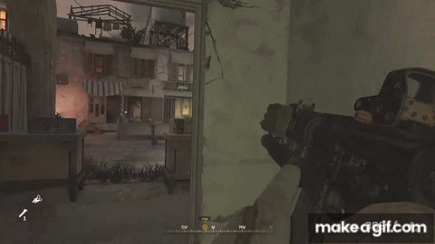
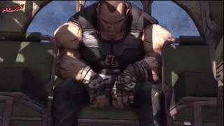

Post game
The Sims 1 (2000, Maxis, EA)
Ratchet & Clank (2002, Insomniac)
Tony Hawk Pro Skater
(2002, Activision)
Need for Speed Underground (2003, EA)
World of Warcraft (2004, Blizzard)
GTA SA (2004, Rockstar)
Line Rider (2006)
Team Fortress 2 2007, Valve)
Bioshock (2007, 2K)
SuperMeatBoy (2008)
Plants vs Zombies (CapCom, 2009)
Call of Duty MW 2 (2009, Infinity Ward, Activision)
Borderlands 1 (2009 GearBox)
Angry Birds (2009 Rovio Ent.)

Slide 6


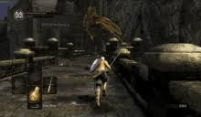


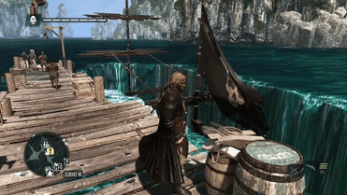

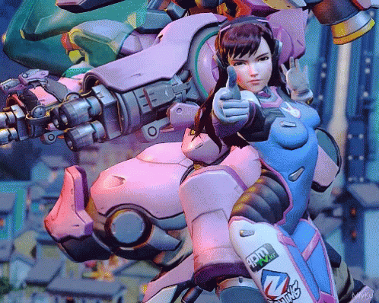

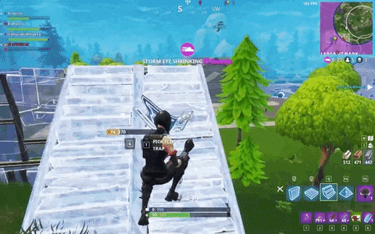



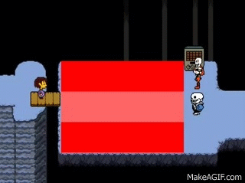
New Game +
Fallout NV (Obsidian, 2010)
Elder Scrolls 5 (2011, Bethesda)
Dark Souls 1 (2011, FromSoftware)
Clash of Clans (2011, SuperCell)
Candy Crush (2012, King)
Assassins Creed 4 (2013, Ubisoft)
Watchdogs 1 (2014, Ubisoft)
Stardew Valley (Concerned Ape, 2016)
Undertale (Toby Fox, 2015)
Overwatch (Blizzard, 2016)
Fortnite (EpicGames, 2017)
PUBG (Pubg Corp. 2017)
Baba Is you (Avri Taikari, 2019)
Ori (Moon Studios, 2020)

Slide 7
Game over (thanks for plaing)

